Slide 1
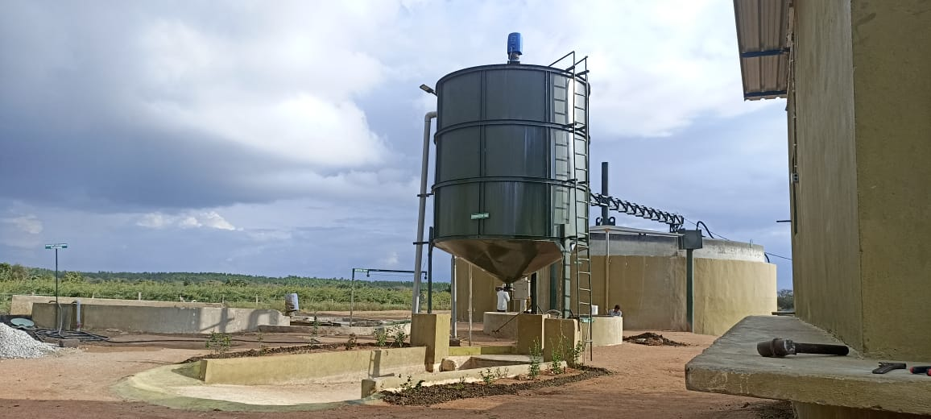

APPLYING SCIENTIFIC WASTE MANAGEMENT TECHNOLOGY
FOR
LITTER WASTE IN POULTRY FARMS
Urja Bio System Pvt. Ltd.
302, Amelia, Rege Path, Lakaki Path,
Model Colony, Shivajinagar, Pune -411006
Phone - +917774043040
www.urjabiosystems.com

Slide 2

URJA BIO SYSTEM PVT. LTD.
More than 250 installations of biogas to power generation projects across India.
15 Years extensive experience in waste treatment sector.
More than 10,000 installation of family size plants in Maharashtra.
15 Projects for community based biogas for Villages, 5 CBG projects.

Slide 3
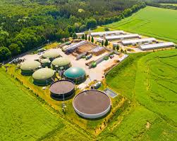
BIOGASS CONCEPT
The Term Biogas refer to the mixture of gases primarily containing CH4 (Methane), CO2(Carbon dioxide) trace of H2S originated from anaerobic ( in absence of oxygen ) degradation of organic material.
Wet waste will be treated in the Bio gas plant to generate Bio methane.
The Bio-methane is a very reliable fuel for cooking food or can also be converted in to Electricity for street lights or for pumping the water.
Bio gas plant also gives one more important bi product i.e. high quality organic fertilizer, which can be used in the Garden of the urban areas.

Slide 4
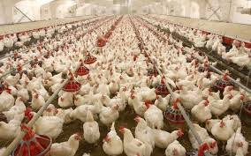
INDIAN POULTRY INDUSTRY
India’s livestock population is amongst the highest in the world. The livestock sector contributes approximately 4% to GDP and 27% to agricultural GDP.
Poultry contributes to 15% of total food energy and 5% of dietary protein.
Over the past three decades, the poultry sector has been growing at more than 5 percent per annum and its share in world meat production increased from 15 percent three decades ago to 30 percent currently.
In addition to providing nutritional security to the poor, it offers provides direct and indirect employment to over three million people and have been one of the key contributors within the livestock sector.

Slide 5
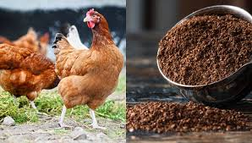
INDIAN POULTRY SECTOR STRENGHTS
Global No. 3 Egg producer and No. 5 Poultry meat producer in the world.
Poultry products account for more than 75% of the non- vegetarian items consumed in India.
Industry growth rate of 12%-15% pa compared to a National GDP growth rate of 9%.
At present India produces about 6.25 to 8 million tones of poultry manure annually.

Slide 6
ENVIRONMENTAL CONCERNS
SOIL QUALITY CONCERNS
Accumulation of nutrients and other elements in soil due to continuous application of excess quantities of manure.
Acidification of non-agricultural soils, due to nitrogen deposition related to ammonia and nitrous oxide emission
ECOSYSTEM AND HABITANT CONCERNS
Destruction of fish habitat
Destruction of Riparian Areas
Eutrophication (enrichment) of lakes, rivers, and ponds
Leaching of nitrate and possible pathogen transfers to groundwater

Slide 7
AIR QUALITY CONCERNS
Odor
Ammonia
Germs
Dust
Air Pollution and Toxic Hazards Associated with Poultry Litter Incineration.
Dirtier than Coal Plants .
Largest source of sulfuric acid.
Second largest source of hydrochloric acid
WATER QUALIITY CONCERNS
Organic Matter (BOD)
Nitrogen (N) and Phosphorus (P) in surface water
Nitrate in ground water
Germs
Salts, Arsenic, Copper, Zinc
Antibiotics and hormones

Slide 8
Role of Urja at Poultry Waste Management
The challenge in litter is its heavier silica and lighter feather content.
So its difficult to deal with waste having such contents.
Urja Bio System has focused and succeeded to remove those two extremely opposite nature impurities by providing suitable inbuilt design.

Slide 9

How Biogas Plant Works ?
Digester
Influent …
Organic N
Ammonium N
Phosphorus
Potassium
Effluent …
Ammonium N
Phosphorus
Potassium
Slurry
Settled solids
Anaerobic digesters do not significantly reduce manure nutrient content.
Solids accumulated in the bottom of the digester also contain some P & N
Ammonium N increases as Organic N is transformed in the anaerobic process.
Nutrients are not reduced through the anaerobic process

Slide 10
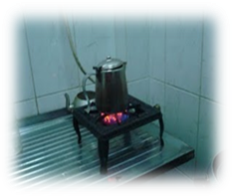
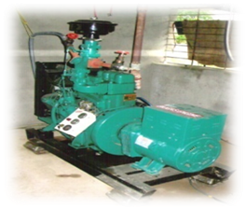
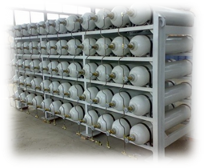
OPTIONS FOR BIOGAS UTILIZATION
Biogas generation has thermal application or replacement to LPG.
Used for cooking purposes in Households, Industrial Canteens, Hotels & Restaurants.
Biogas generated is used to produce power, replacement of LDO or FO in Industries.
Can be used at Industries which produce bulk waste
Apartments. Biogas Generated is used to run a Biogas Engine
Biogas generated is used for CNG production.
Replacement for petrol, Diesel in Vehicles.

Slide 11
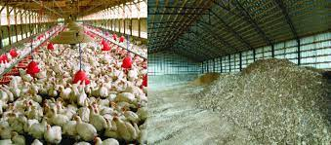
LIST OF SUCCESSFUL INSTALLATION OF BIOGAS
PROJECT BASED ON POULTRY WASTE
Srinivasa Hatcheries, Hyderabad.
Avee Broilers, Nashik.
Geetanjali Breeders, Village Gulunche, Pune.
V R K Nutritional Solutions, Sangli.
Mrittika Greens, Kolkata

Slide 12

Venky Poultry, Roha.
Sunanda Agrovet, Lonand.
Siddhivinayak Poultry, Kurkumbh.
Om Chicks, Yawat.
Raj Rajeshwar Hatcheries, Hydrabad.
Amrit Breeder Farm, Polachi.
Sunmax Poultry, Hydrabad.
Jai Kissan Hatchery, Jind.
And Many More….

Slide 13
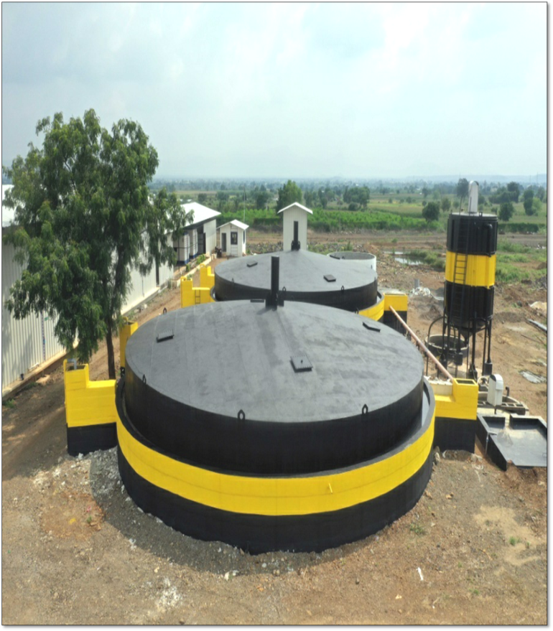
CASE STUDY OF ANAND AGRO BIOGAS PLANT, NASIK.
Plant Capacity : 20 ton per day
Biogas Generation: 2000 cum
Electricity Generation : 2500 kWh/ day
Scrubbing System : 100cum/hr
Biogas engine : 100 kW x 02 nos.
Biogas Storage capacity : 600 cum
Liquid Manure Generation : 50,000 lit/day
MEDA Subsidy : 80 Lacs
MNRE Subsidy : 50 Lacs
Client is enjoying almost complete independence for his power need through bio power.

Slide 14
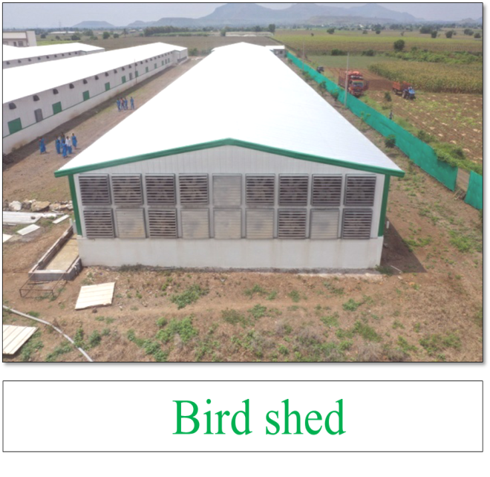
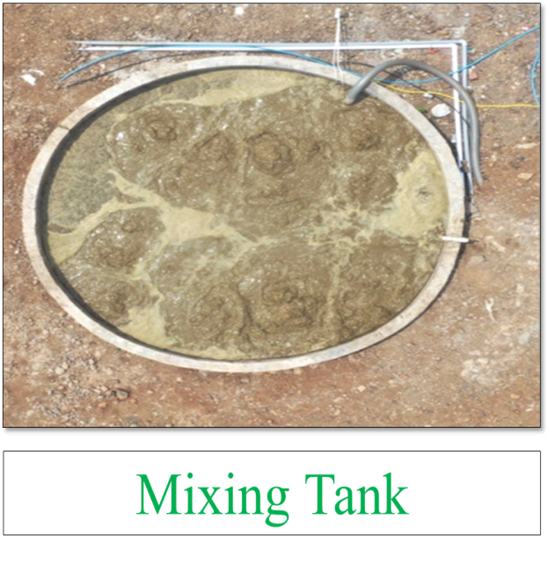
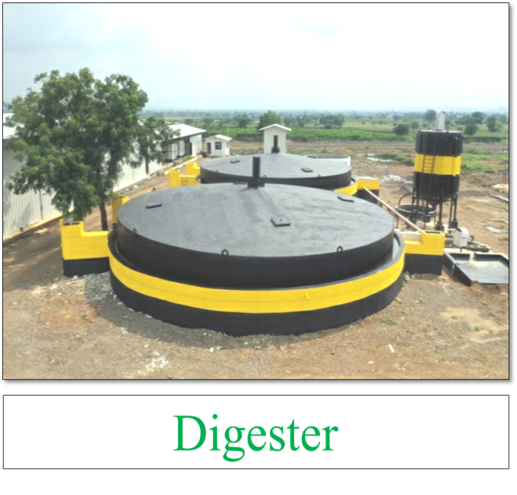
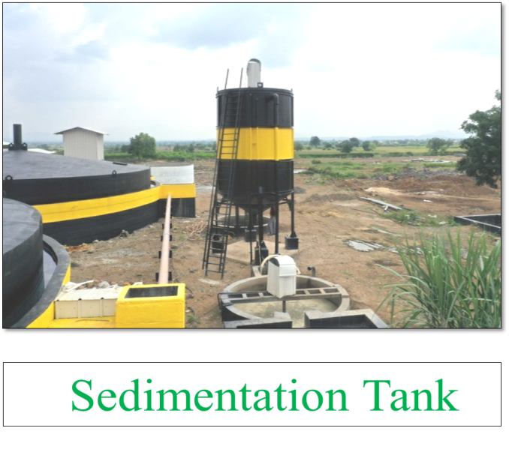
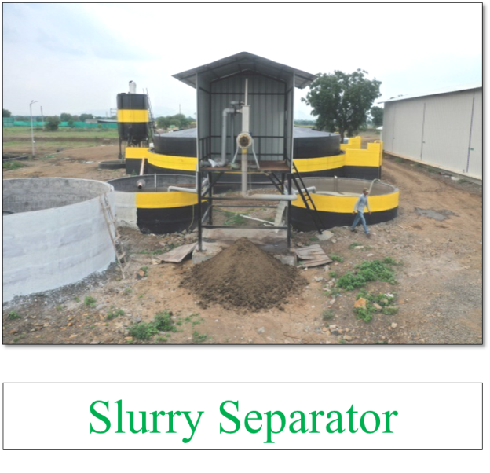
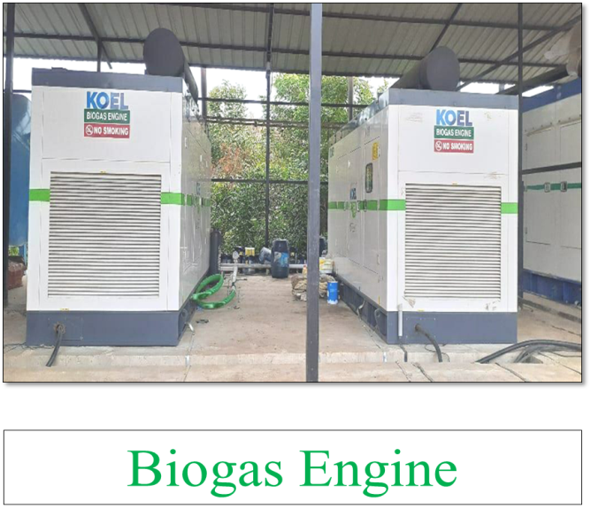
PLANT PHOTOS

Slide 15

MANURE PROCESSING FOR BETTER VALUE ADDITION TO PROM
Instant slurry will filtered to separate solids and Liquid.
Solids will be dried and mixed with rock phosphate to produce Phosphate Rich organic manure (PROM).
Further value addition as per requirement can be done to fetch better revenue.

Slide 16
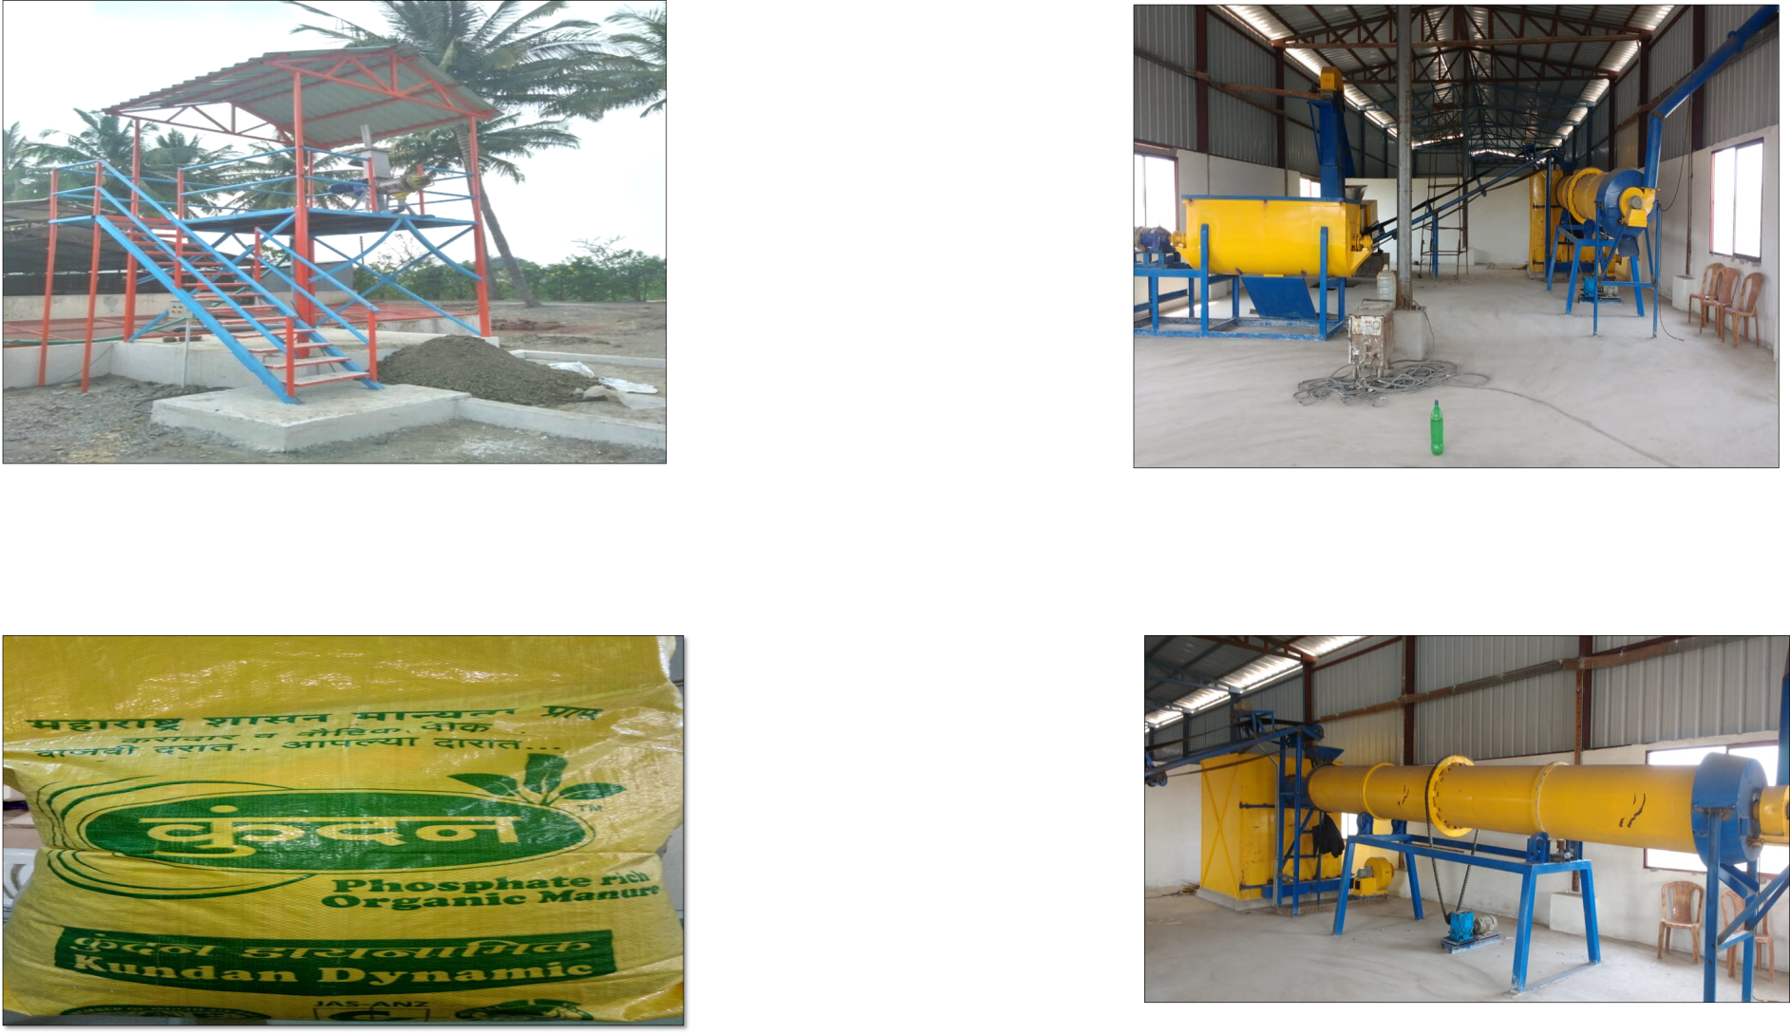
PROCESSING OF MANURE INTO PROM
Slurry Separator
Mixing and blending machines
Actual PROM bag produced at our unit
Granulator

Slide 17
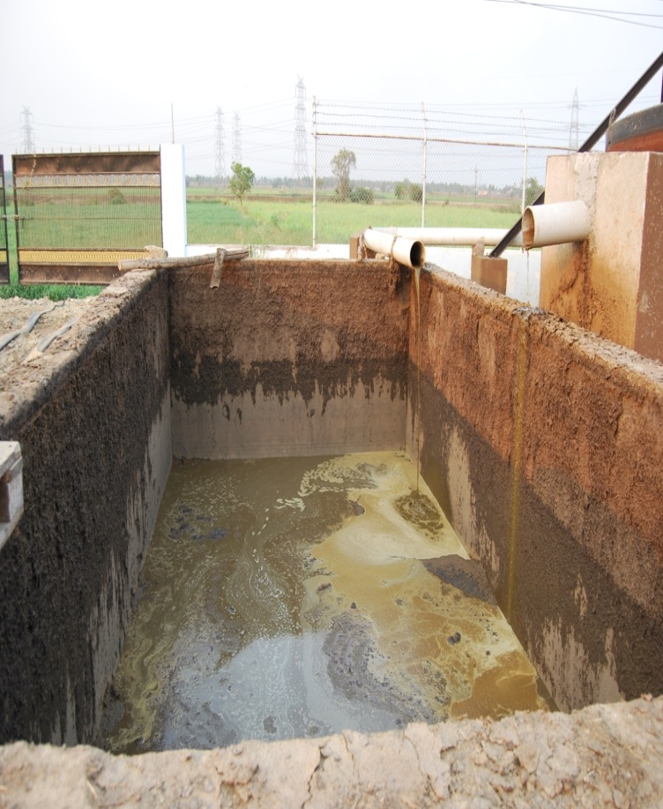
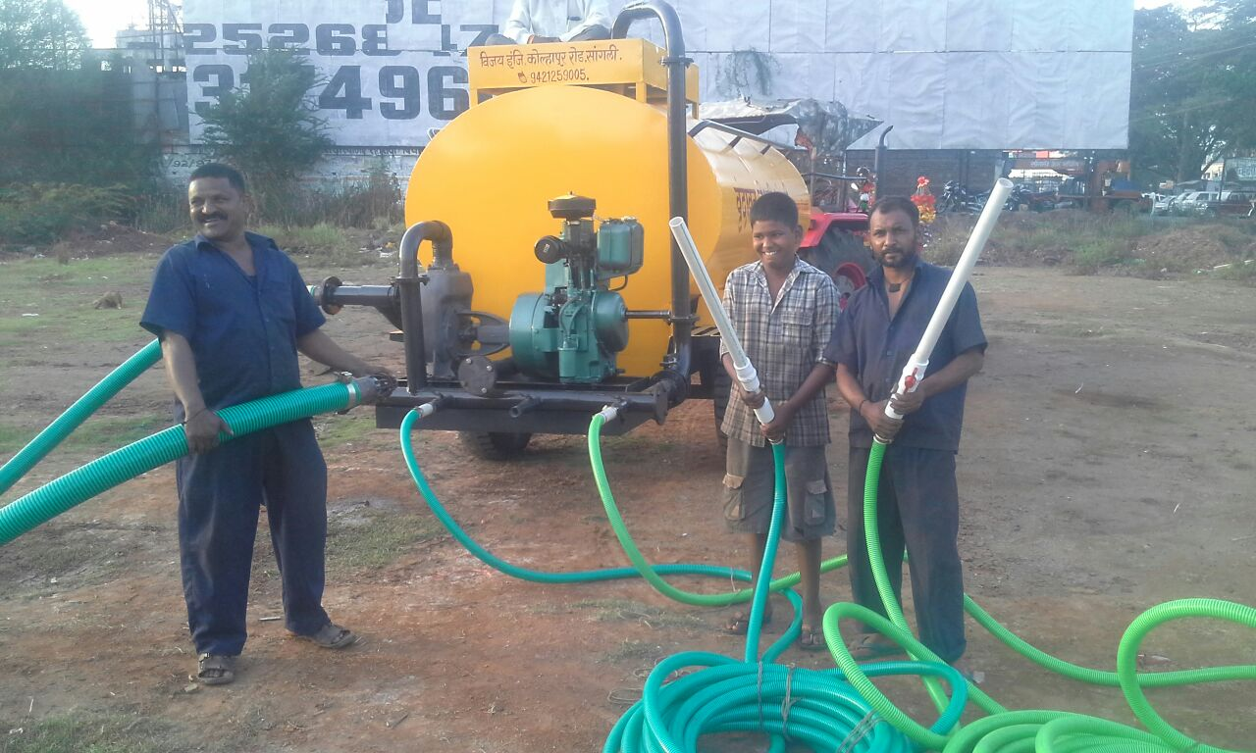
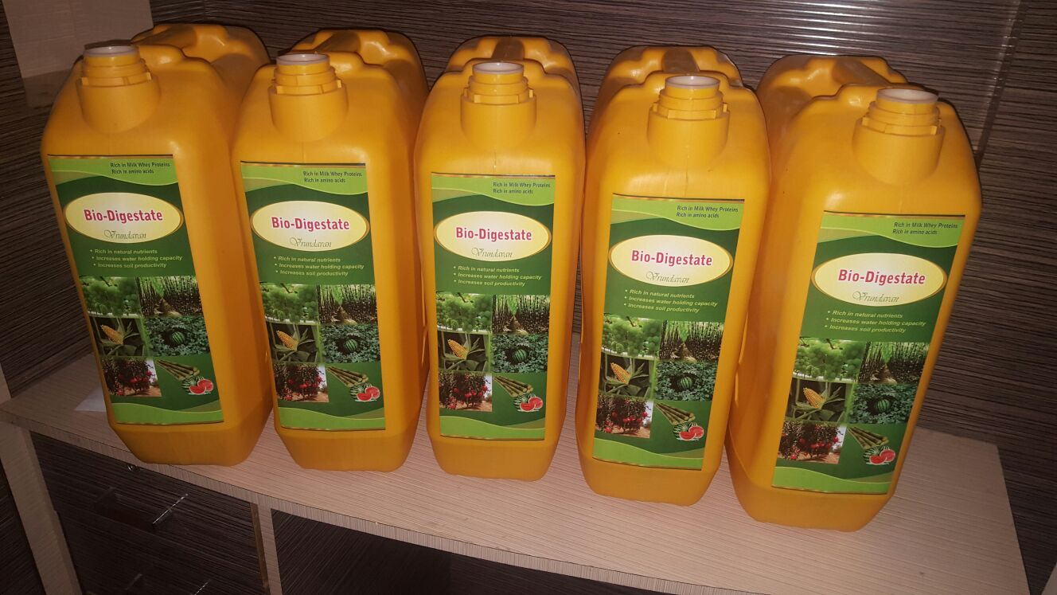
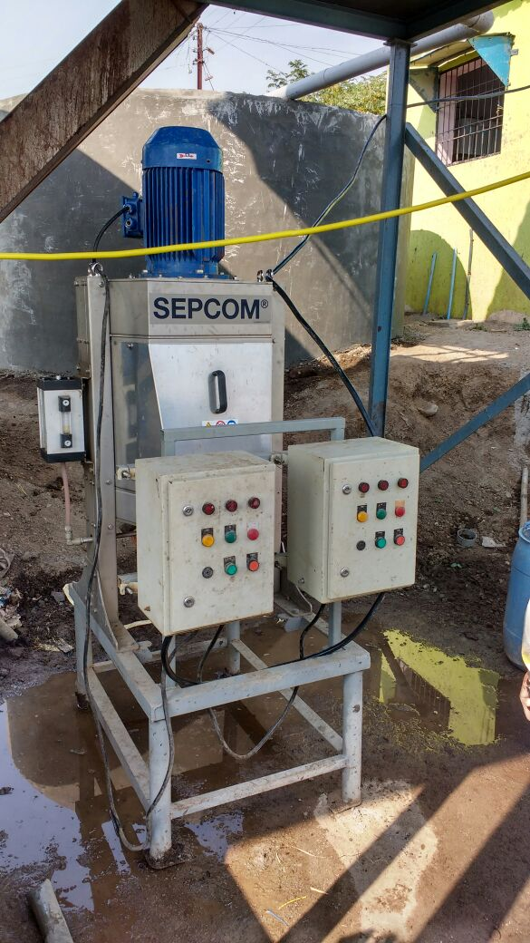
LIQUID FORM OF MANURE FOR MICROFILTRATION & PACKING
Digested Slurry
Micro filter

Slide 18

BIO CNG PROJECTS BASED ON poultry litter
25 TPD Poultry Litter based biogas to Bio-CNG project at V R K Nutritional Solutions Sangali.
60 Ton poultry waste based Bio CNG at Hyderabad for Solika Green Energy.
50 TPD litter based in expected to start in Durgapur, WB.
Another 2 orders of Solika Greens are also in pipe line.

Slide 19
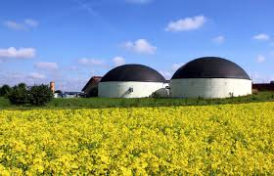
OVERSEAS PROJECTS
7.5 TPD dung waste biogas to power generation plant at Lusaca, Zambia.
5 TPD fruit processing waste to power generation plant at Elvenagri ltd., Dar-E-Salaam, Tanzania.
2.5 TPD dung waste to power generation plant at Gambia

Slide 20
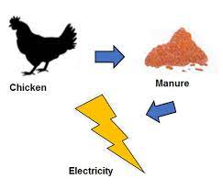
SOCIAL BENEFITS
Job creation for local people
Health improvement - smell reduction, pathogen reduction, dieses reduction due to utilization of clean energy & end products use as land fertilizer instead of chemical fertilizer.
Lifestyle improvements

Slide 21

ENVIRONMENTAL BENEFITS
Protect forest
Avoid GHG emissions (CO2, CH4 reduction)
Clean environment

Slide 22
RESOURCE CAN’T BE WASTE
LET’S CONVERT IT TO BEST

